Slide 1
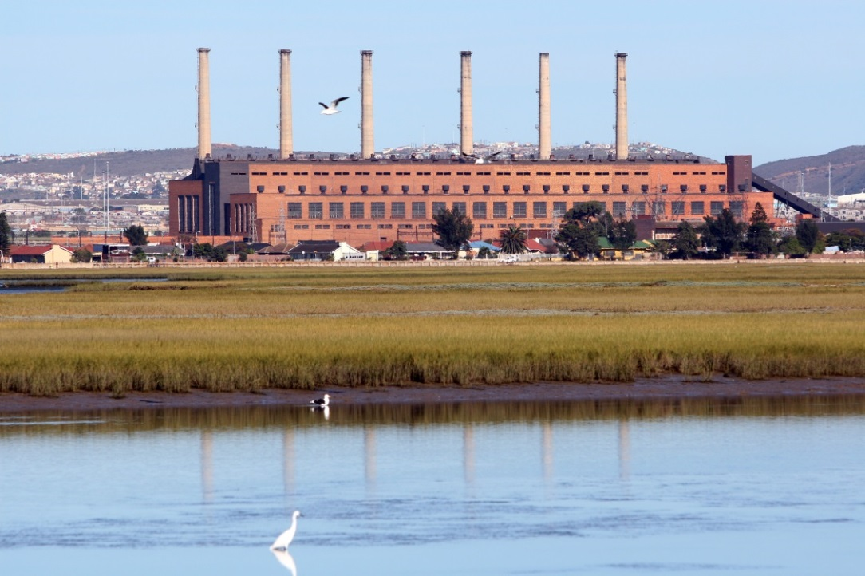
CLIMATE CHANGE PRESENTATION Prepared by Pearl Jonas
“Creating Climate Change Resilient Communities”

Slide 2
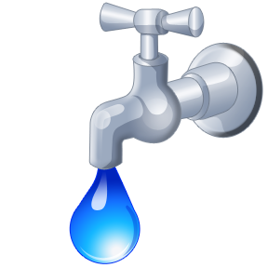
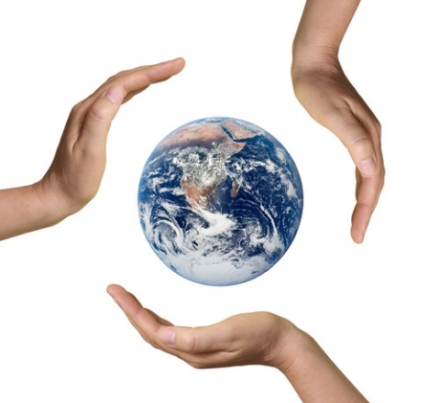
“QUOTATION” Senegalese Doctor
“In the End, We will Protect and Conserve what we Love…We will love what we Understand and We will Understand what we have been Taught”

Slide 3
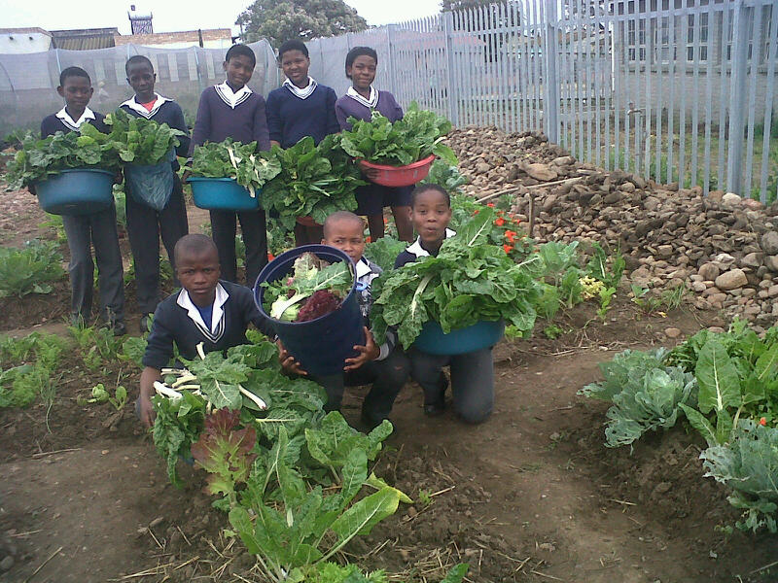
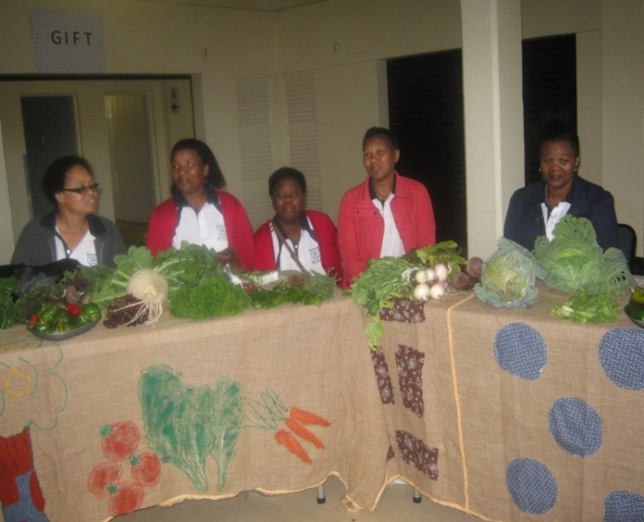
OBJECTIVE/ PURPOSE
To learn about how individual and collective lifestyles can influence climate change and learn how to be climate resilient in a changing world
Ensure communities have power to be the change for sustainability that our world needs by engaging them in fun, action-orientated and socially responsible learning.”

Slide 4
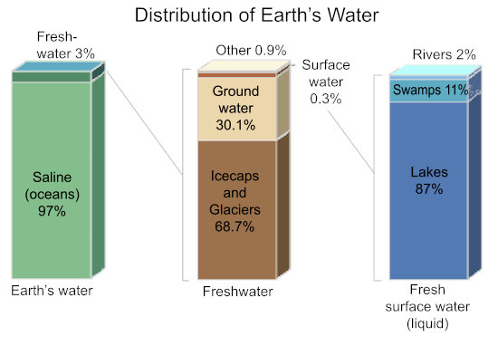
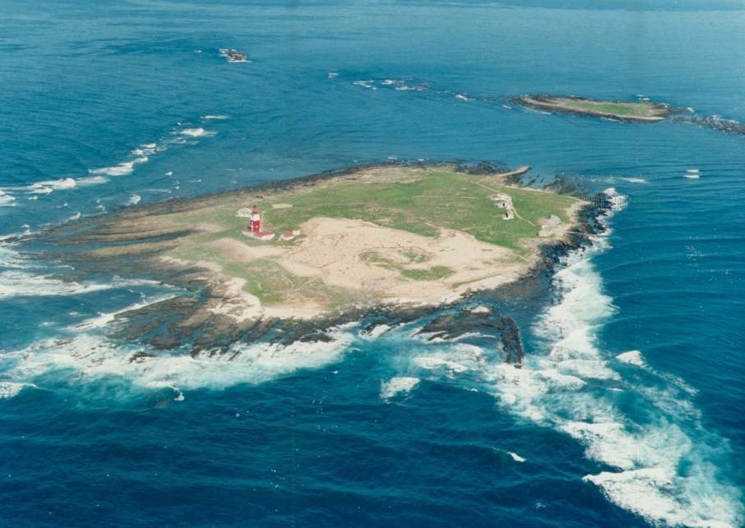
There is a lot of water on earth, but only a small amount is available for us to use

Slide 5
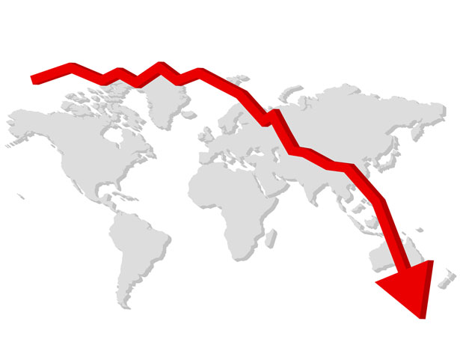
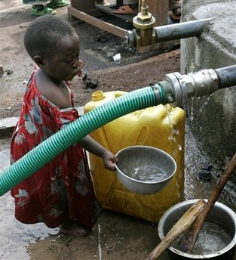
There is not enough fresh water in the world
Fresh water per person
Population growth

Slide 6

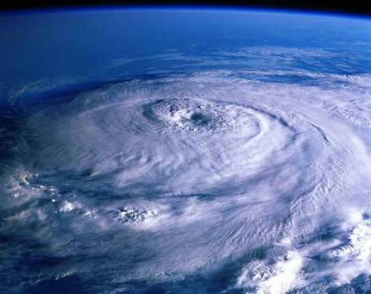
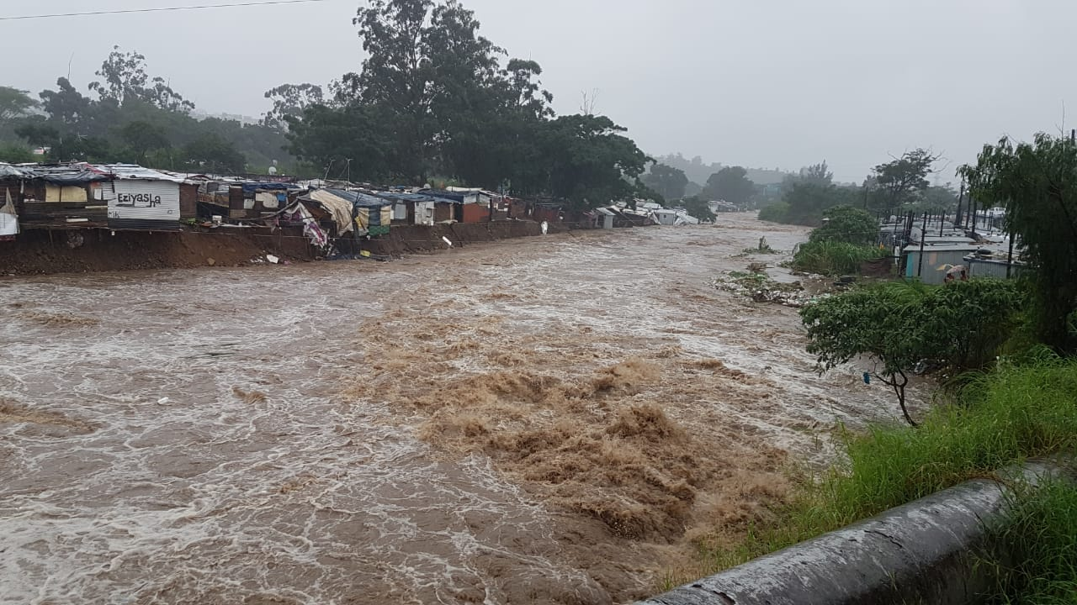
WHAT IS CLIMATE CHANGE
A change in weather patterns on global scale, temperature, timing of seasons & rainfall.
CAUSED by
Global Warming as a results of Greenhouse gases.
Notes:
CC will have a severe impact on SA: shift plant biomes SE-wards, less rain (less crops), more floods, hotter summers, worse droughts and storms, Benquela Current sped up (disaster for WCoast agriculture and Fisheries), more frequent El Ninos (more frequent droughts)

Slide 7
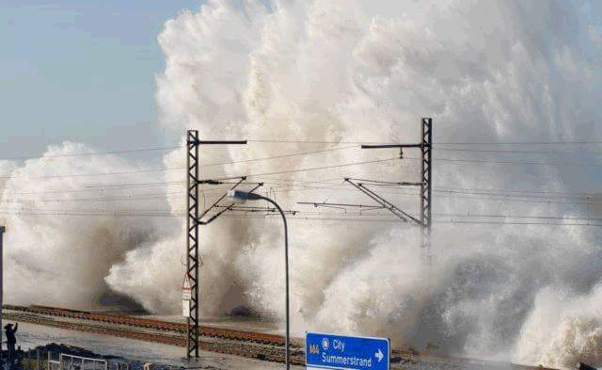
Rising Sea Levels

Slide 8
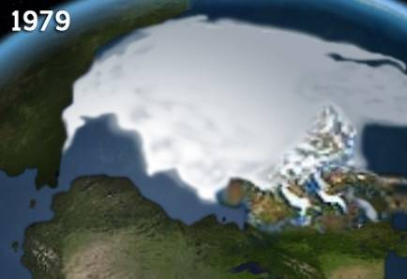
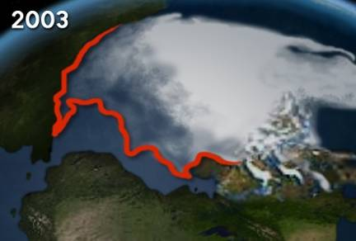
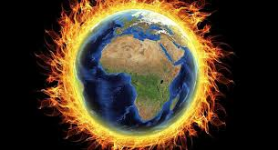
Global Warming
Increase of temperature in the Earth’s lower atmosphere caused by increase in greenhouse gases.
Melting ice-caps – proof that planet is heating up, and the seas are rising

Slide 9
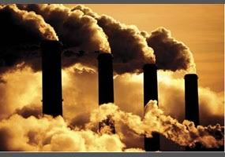
Industrial Zones and Greenhouse Gases
Gases:
Carbon dioxide
Water vapour
Chlorofluro carbon (CFC)
Methane

Slide 10
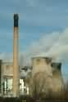
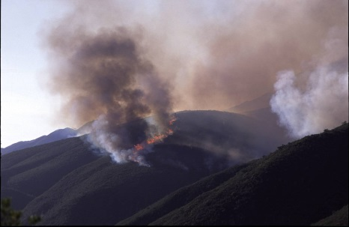
Causes of Climate Change
Greenhouse effect
Global warming
Transportation
Industrial zones & green house gases
Deforestation
Waste management

Slide 11
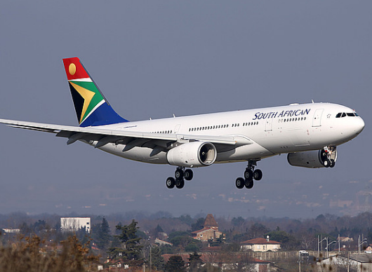
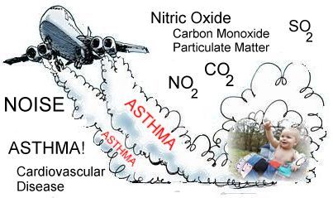
Transportation
Mechanical transport causes air pollution:
Vehicles emit CO₂
Jet aircraft are the highest CO₂ emitters

Slide 12
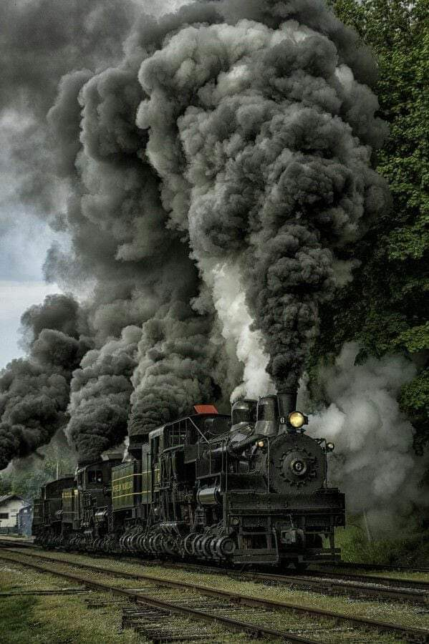
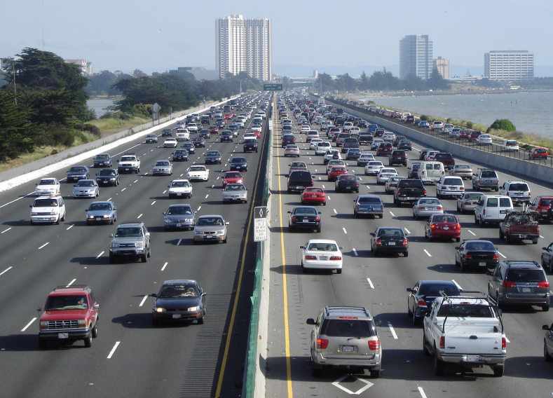
Cars & Trains

Slide 13
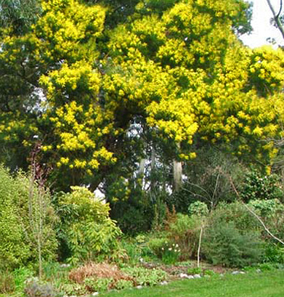
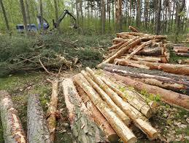
Deforestation
Trees are important for carbon sequestration & deforestation slows down the process of carbon sequestration
It also affects biodiversity

Slide 14
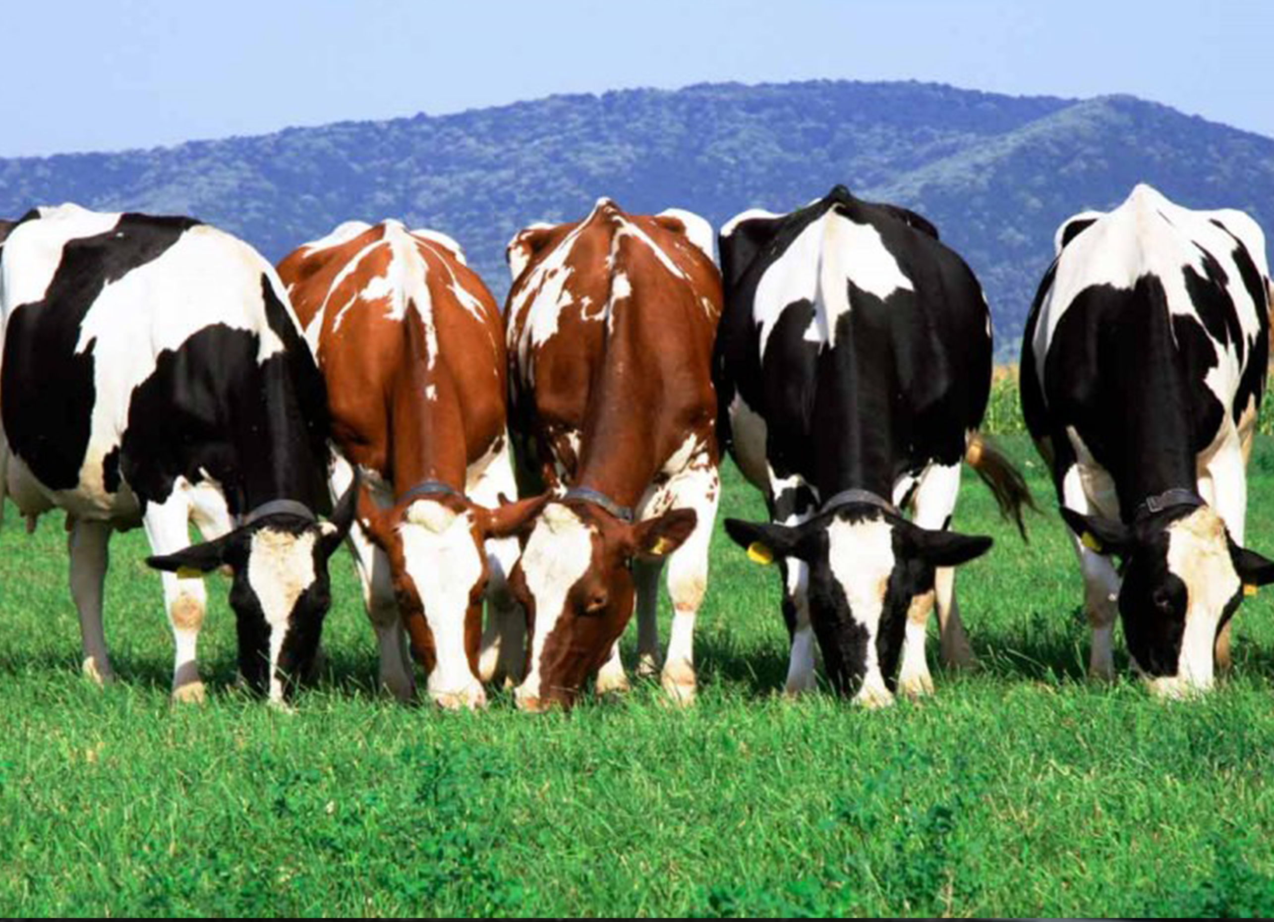
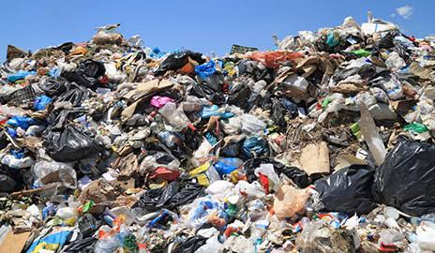
Methane
COW’S DUNG
LANDFILL SITES

Slide 15
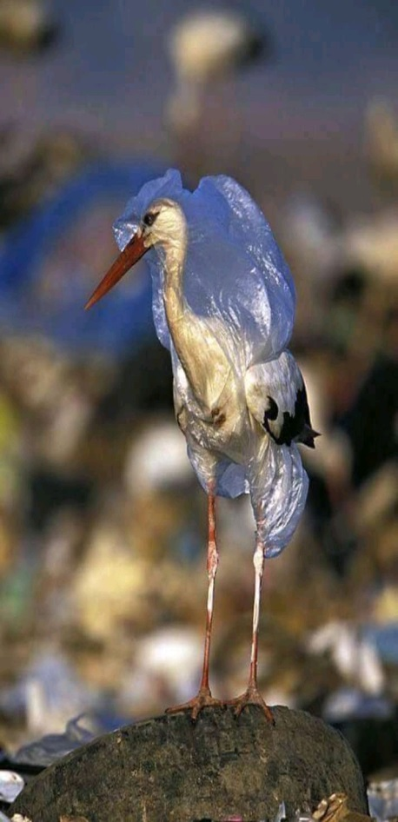
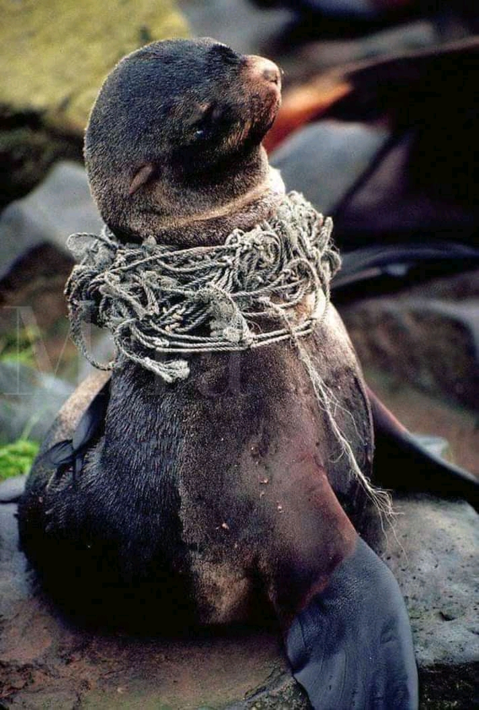
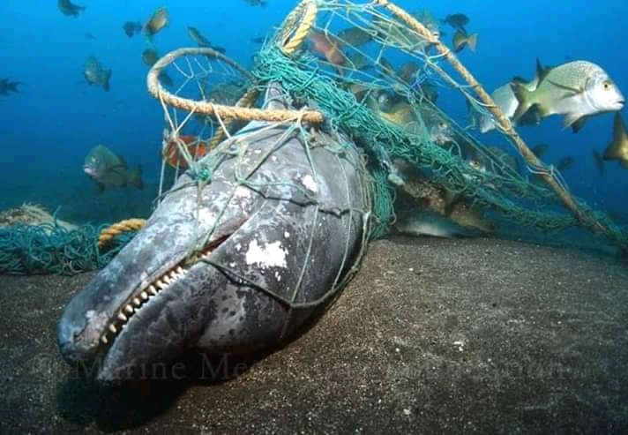
Waste Impact on marine life

Slide 16
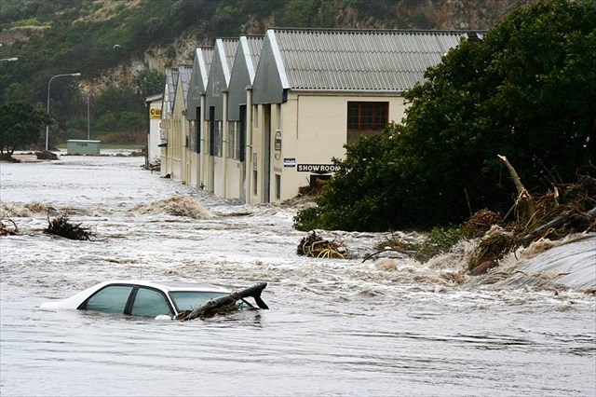
Resulting To:
Disruption of our Ecosystem & Biodiversity
More Floods and Droughts
Extinction of certain species
More diseases which results to death
Sea Levels Rising
Warm Seas
Economic Depression

Slide 17
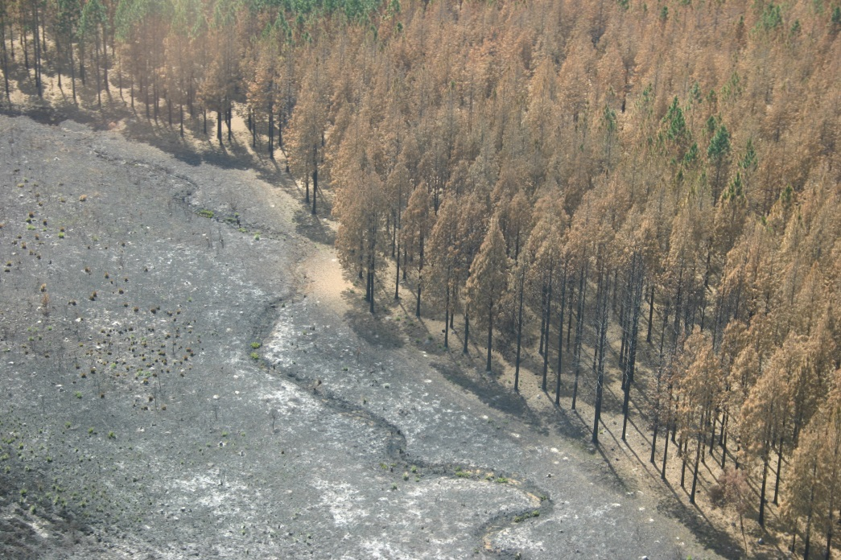
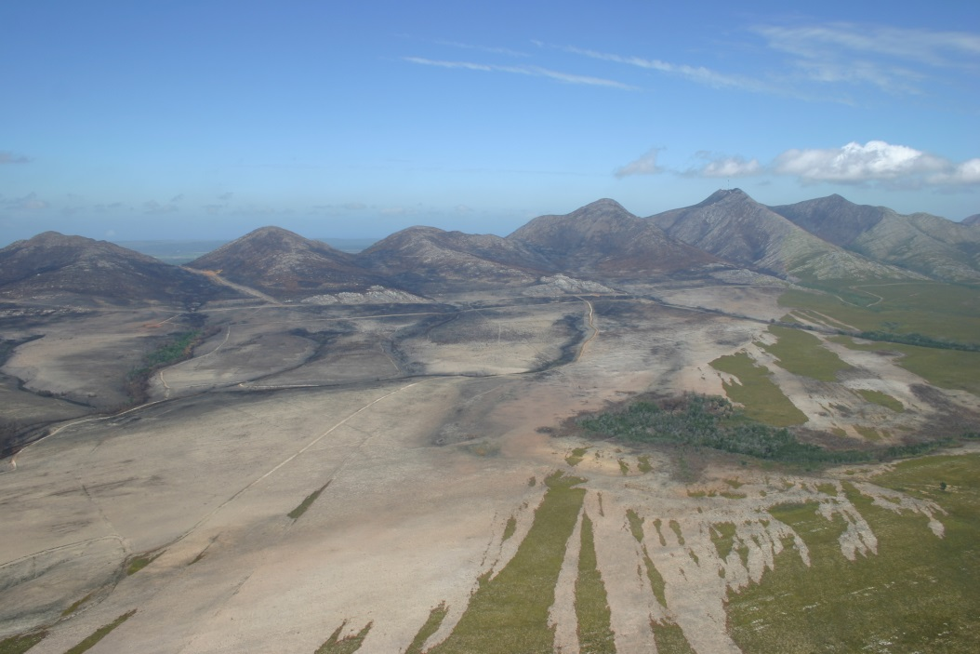
FIRE DISASTERS

Slide 18
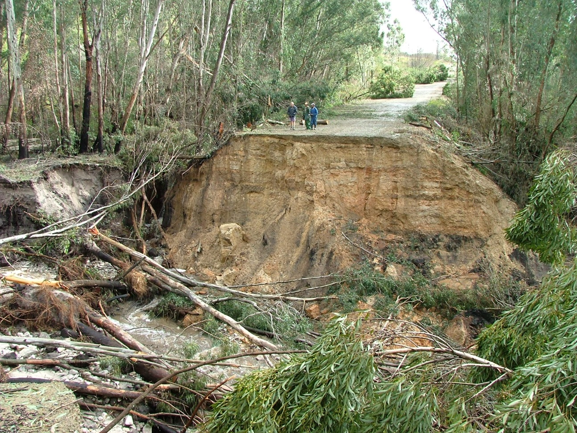
Elands River Road

Slide 19
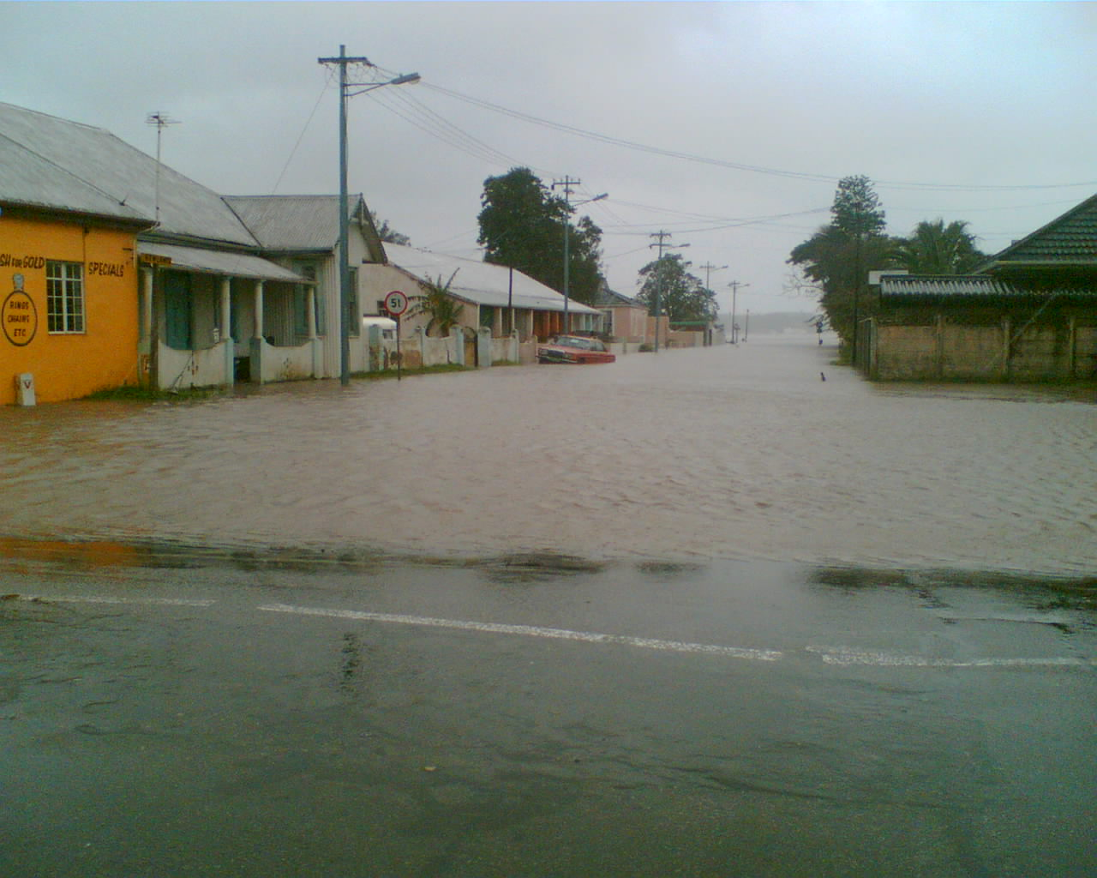
SWARTKOPS AREA

Slide 20
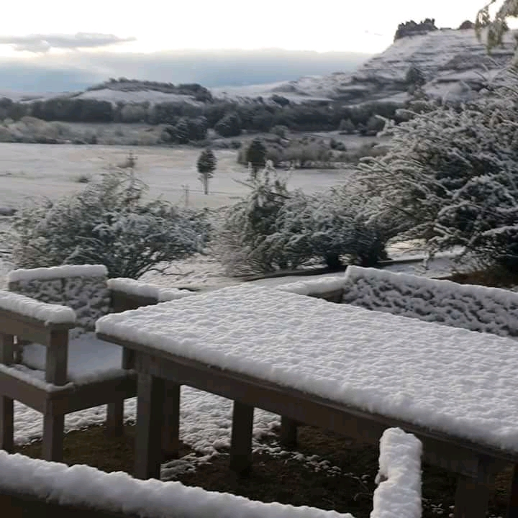
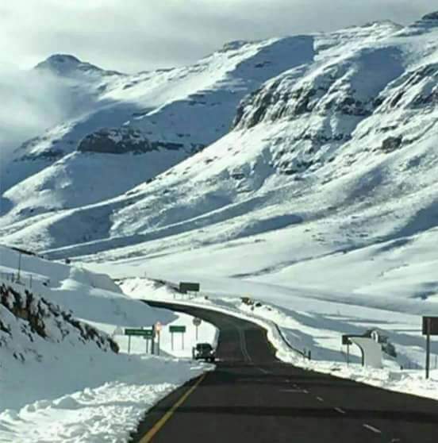
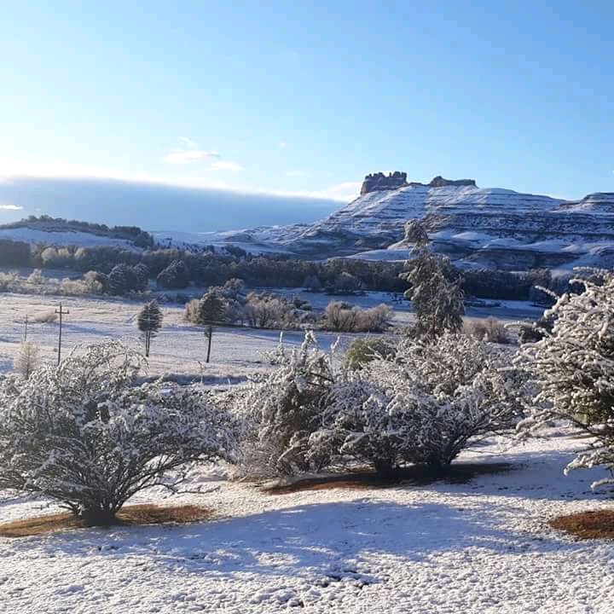
EXTREME COLD WEATHER

Slide 21
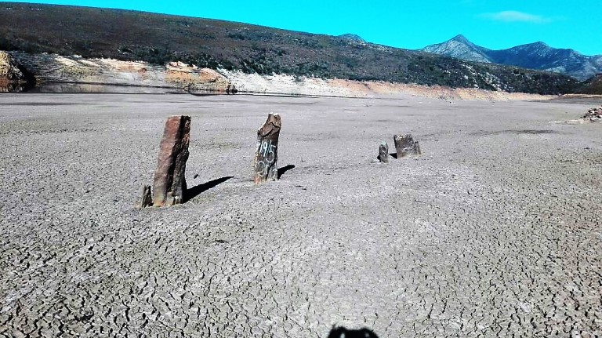
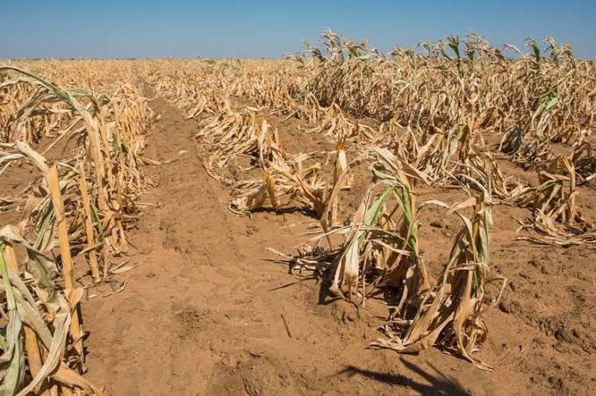
EXTREME DROUGHTS

Slide 22
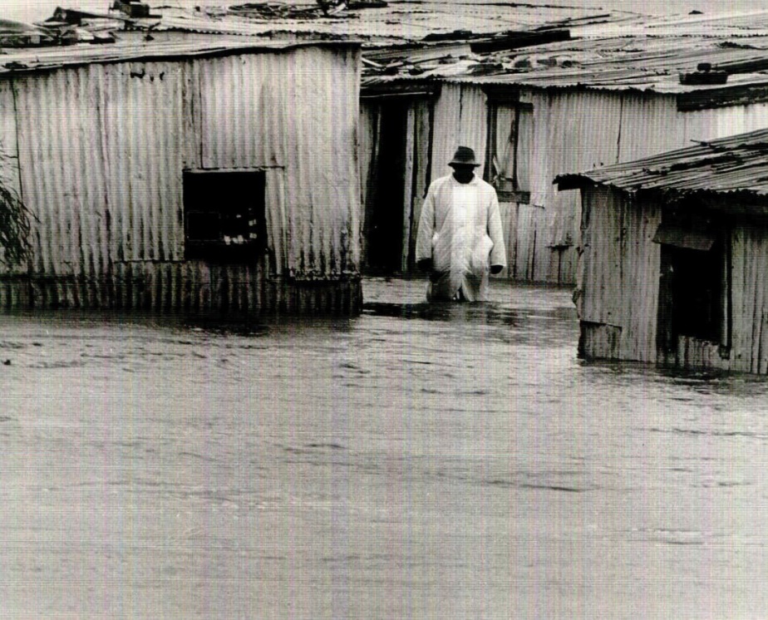
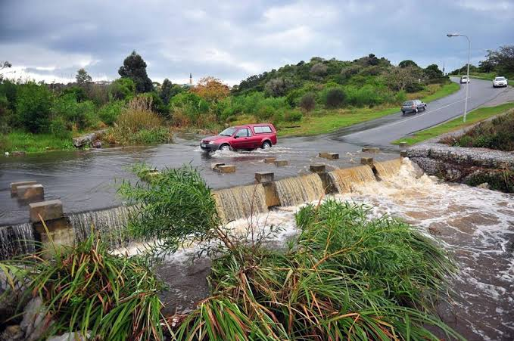
LOCAL FLOODS

Slide 23
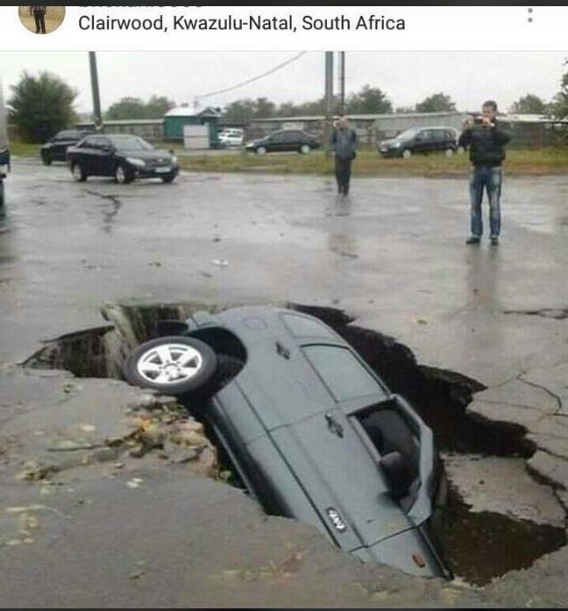
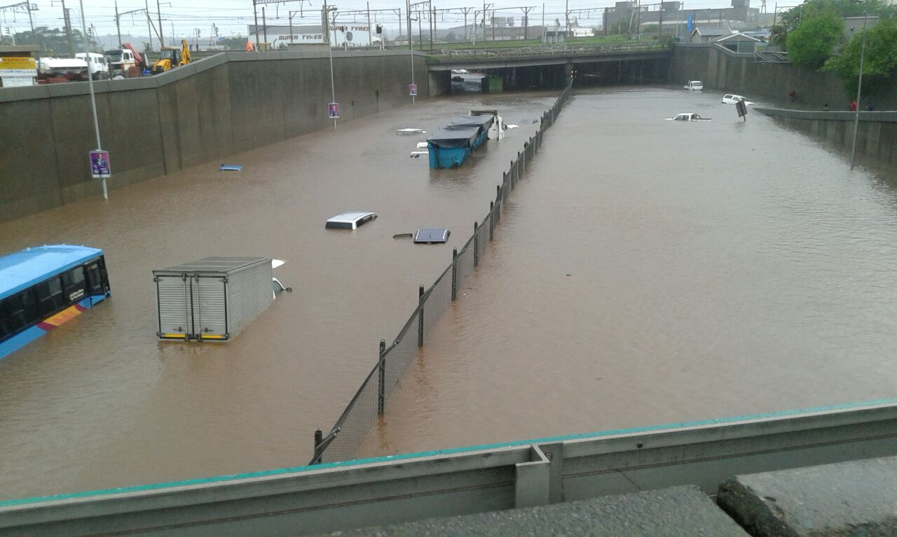
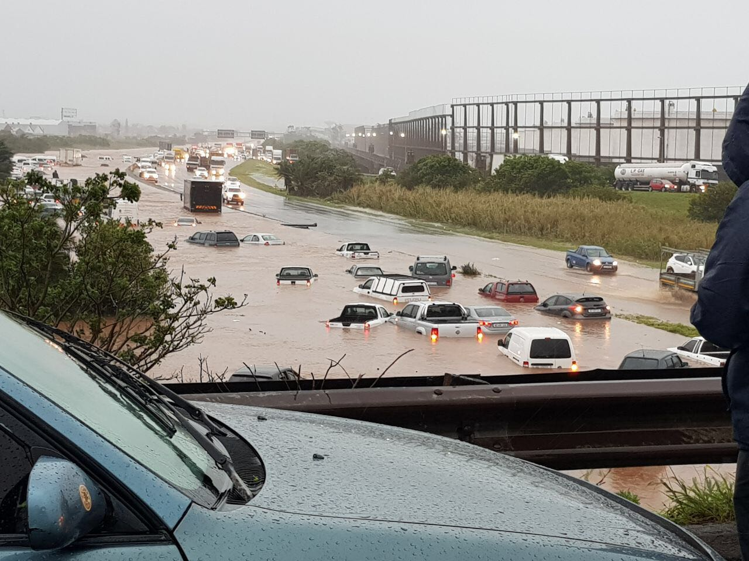
KZN 10 Oct 2017 Floods

Slide 24
HOW WILL SOUTH AFRICA BE AFFECTED ?
Over the next 50 years:
Shift of plant biomes SE-wards
Western Cape rainfall will be reduced with 25%, northern provinces will be about 5% less.
About 70% of the animals in the Kruger National Park will die as a result of habitat change.
By 2020 the rivers in the western parts - 10% less water.
In the interior provinces the summers are expected to be between 2,5 and 4,5 ºC warmer.
Benquela Current sped up (disaster for WCoast agriculture and Fisheries), more frequent El Ninos (more frequent droughts)
Eastern Cape: drier in West, wetter in East (more flood prone)
All these changes will greatly affect agricultural practices, reduce job opportunities and lead to severe poverty.

Slide 25
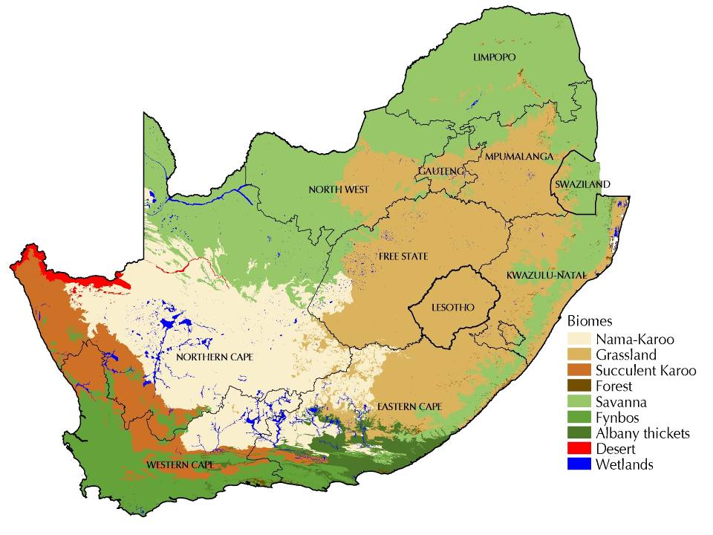

Slide 26
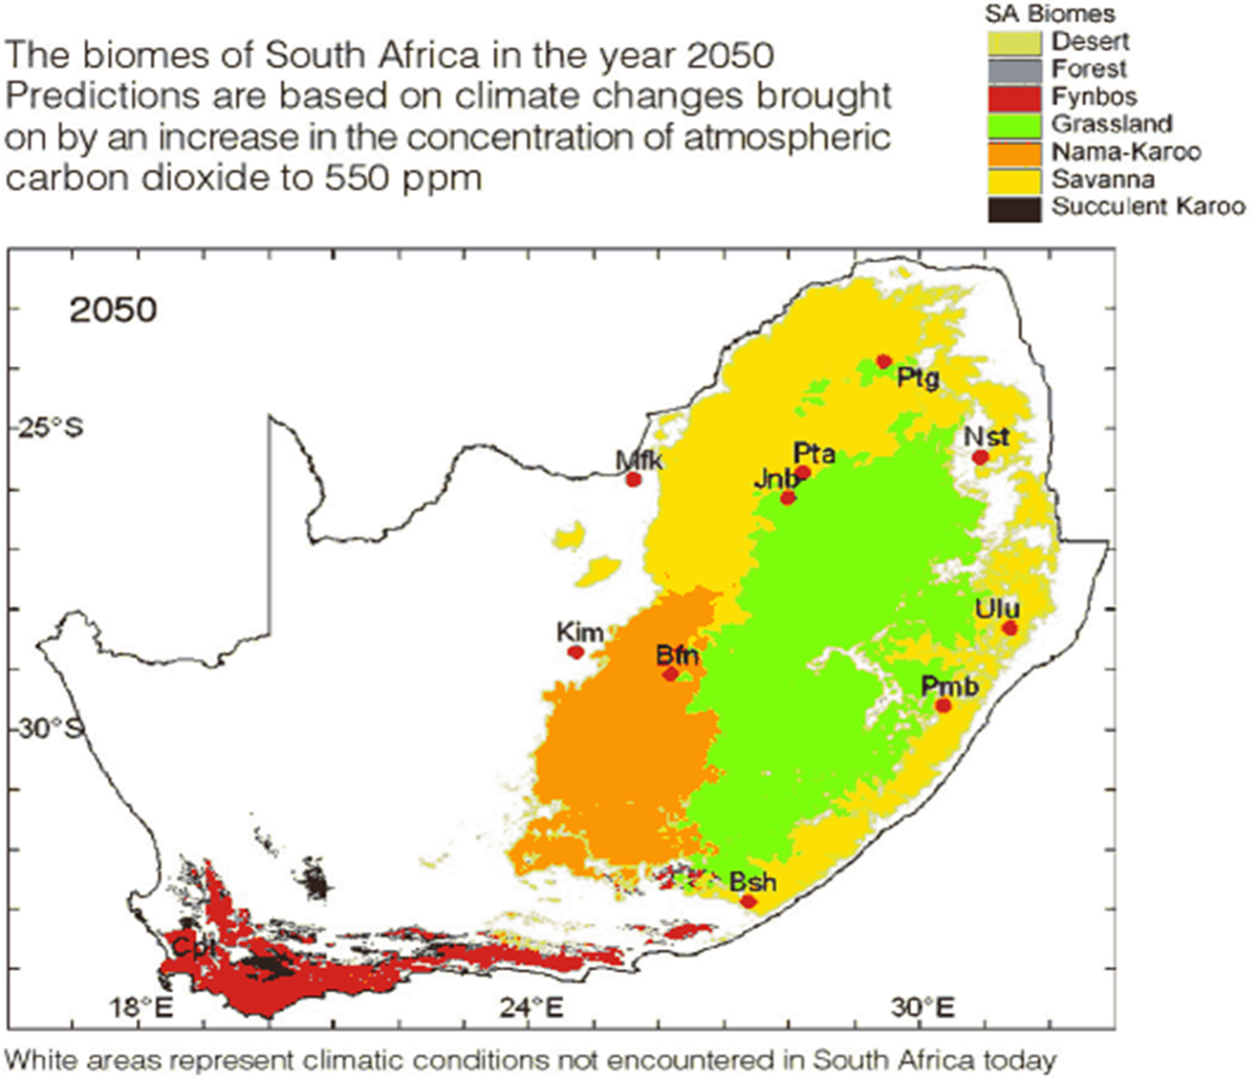

Slide 27
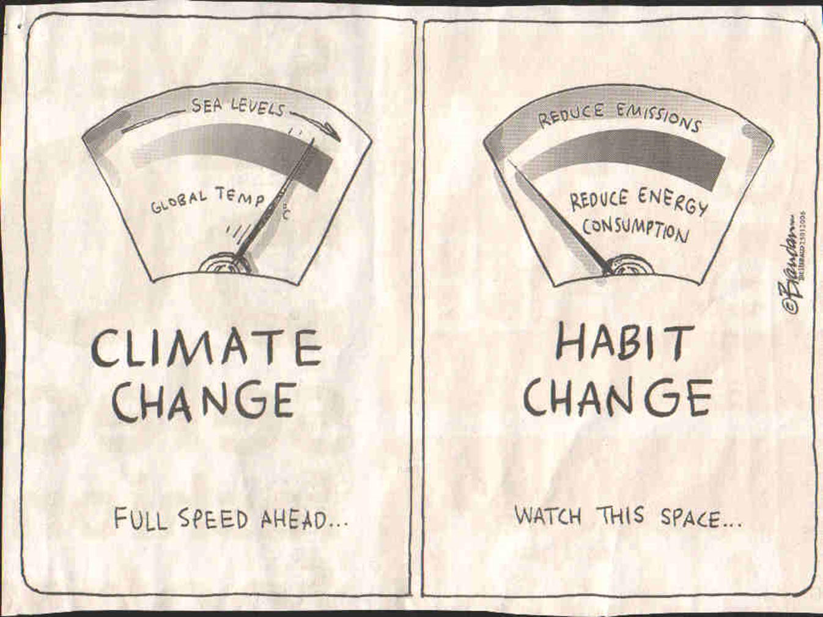

Slide 28

MITIGATION & ADAPTATION STRATEGIES
Learn lessons from others;
Government has prepared a draft Climate Change Adaption Strategy;
Prepare policies, strategies and action plans for various aspects of climate change. Eg.:
Disaster Management Plan
Drought Plan
Emergency dam failure evacuation
Alien vegetation eradication
Mitigation plans
Conserve, rehabilitate and restore natural systems that improve resilience to climate change;
Make contribution to the global effort;
Reduce your carbon footprint by benchmarking & behaviour change.

Slide 29
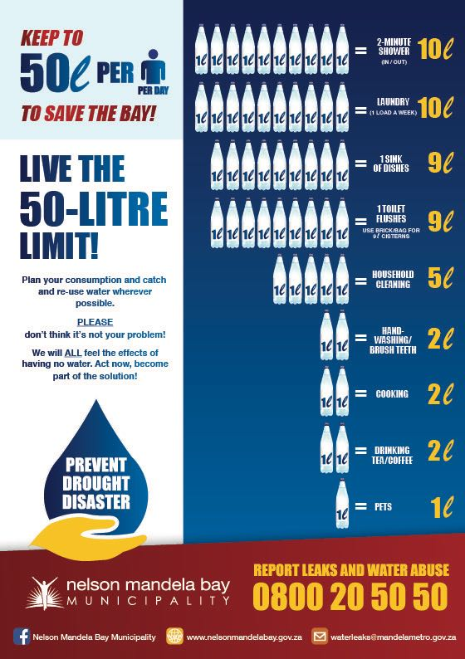
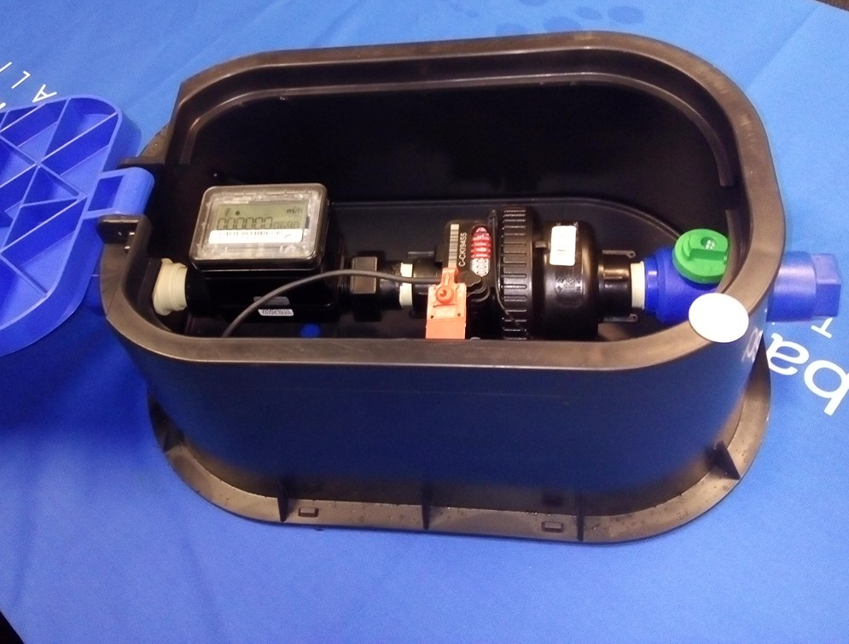
NMBM Water Conservation Strategy

Slide 30
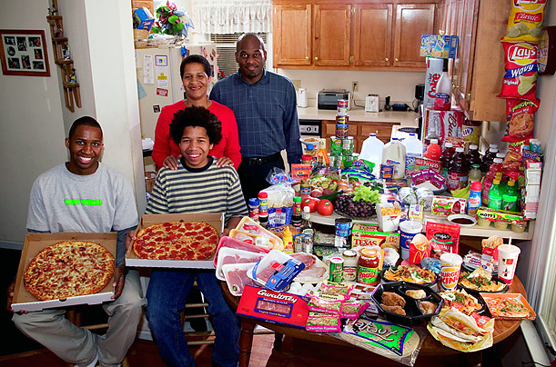

Reduce, Re-Use, Recycle and Recover

Slide 31

THANK YOU!!

